Slide 1
Instructions for Kits with Chain of Custody
Witnessed Collections

Slide 2
For many years, Labcorp has offered an alternative DNA buccal swab collection option, which allows for an individual to witness a participant collecting their own DNA sample, that utilizes a buccal swab collection methodology, while maintaining stringent chain of custody requirements. This DNA buccal swab collection procedure meets the standards and guidance of AABB as long as the parties follow the witnessing requirements noted below and in other slides of this presentation, the party performing self-collection does not participate in packaging the samples, and other collection requirements are followed.
Additional Information The information below was taken from the 14th edition of Standards for Relationship Testing Laboratories.
AABB Standard: Standard 5.2.2 Collection All collections of samples shall be performed or witnessed by a competent person with no interest in the test outcome. Collection materials shall only be sent directly to collectors and/or witnesses. Collection materials shall not be in the possession of any of the tested parties either before or after collection.
Guidance The reliability of the final report is dependent on the authenticity of the samples tested. Here the witness must actually observe the collection and be a competent person with no interest in the outcome. The phrase no interest in the test outcome would disqualify spouses, children of the person being tested, other family members, friends and any person having any relationship to any of the persons being tested. The parties tested should not choose the collector to ensure that the collector is independent, except as follows. Persons who may qualify include ministers, child support workers, physicians, attorneys, or a person hired by the laboratory. Tested parties may not collect themselves, unless the collection is witnessed by a competent person, as tested parties cannot be assumed to be either independent or competent. Collection materials must not be in the possession of tested parties before or after collection to reduce the likelihood of sample tampering and fraud. Therefore, collection materials may only be sent to collectors or witnesses (including third party administrators), not to the tested parties. Regardless of who performs or witnesses the collection, their name and contact information must become part of the laboratory’s permanent record. Reference Standard 6.3A applies. This will allow for investigations of possible fraud.

Slide 3
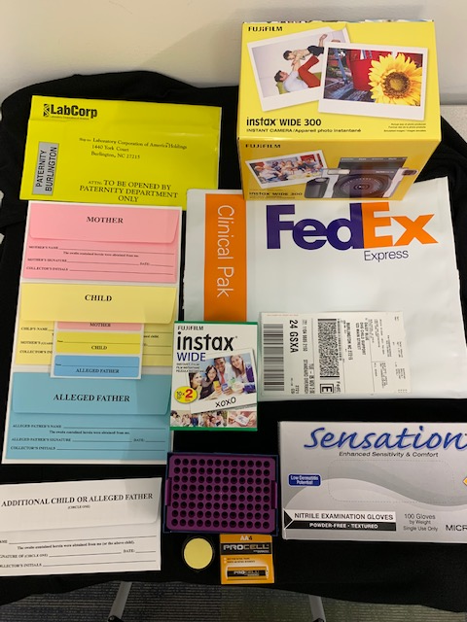
DNA Identification
Supply List
Yellow Tamper Evident Kit Bag
Color-Coded Buccal Swab Collection Kit
Additional Party Envelope
Camera
FedEx Shipping Bag (Clinical Pak)
FedEx Airbill
Film
Drying Rack
Ink Pad (optional)
Camera Batteries
Gloves

Slide 4
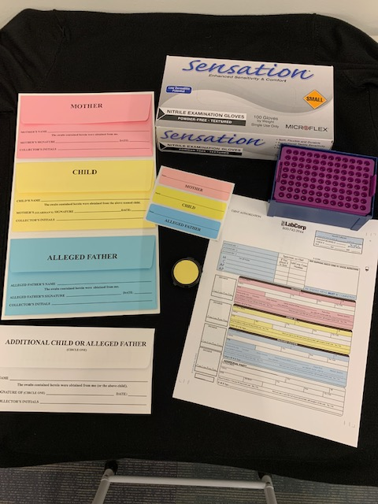
Prepare These Supplies Prior to Collection

Slide 5
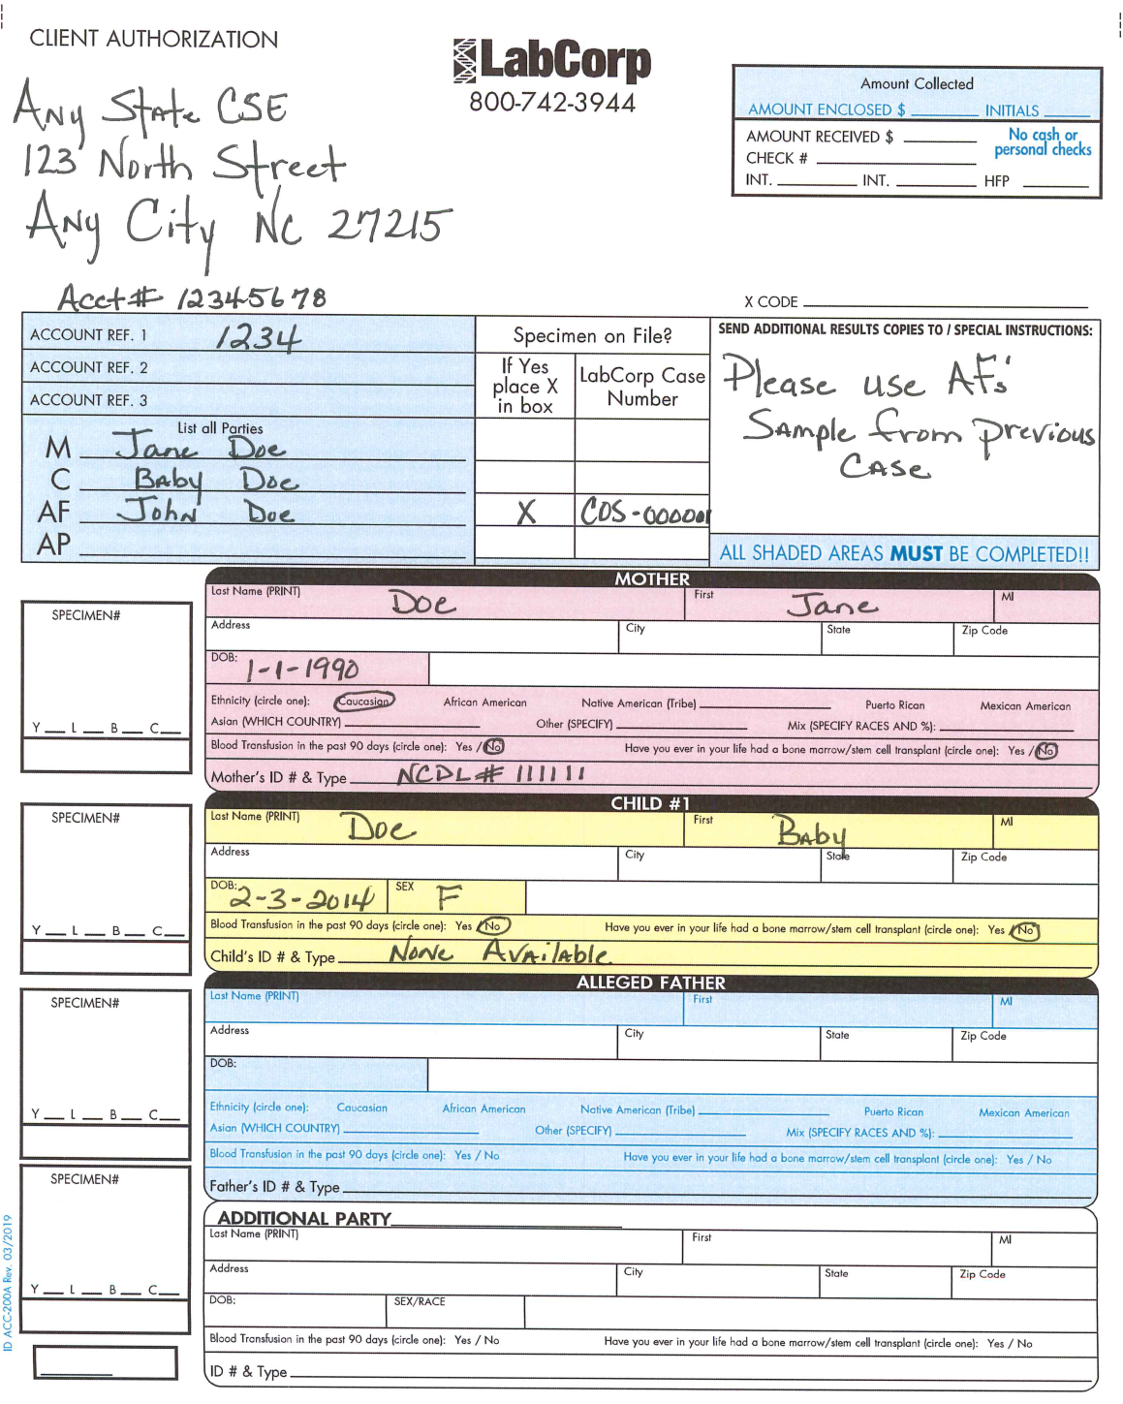
Client Authorization Form
Client name, address, and Labcorp account number must be provided here. Client information is often preprinted in this area, if so, verify that it is correct. Please do not use correction tape. Form must be completed using blue or black ink only.
Record the amount of money collected or “N/A” if none.
Provide Account Reference numbers if applicable.
Note: Only the client can provide additional addresses – not the individuals being collected.
Record the names of all individuals to be collected for this case.
Indicate the race of the individual collected. If “Other” or “Mix” is used, specify races.
Inquire as to Transfusion and Bone Marrow (Stem Cell) Transplant status on all collected persons.
Notate beside “Additional Party” which party was collected such as Child #2 - Alleged Father #2, etc.

Slide 6
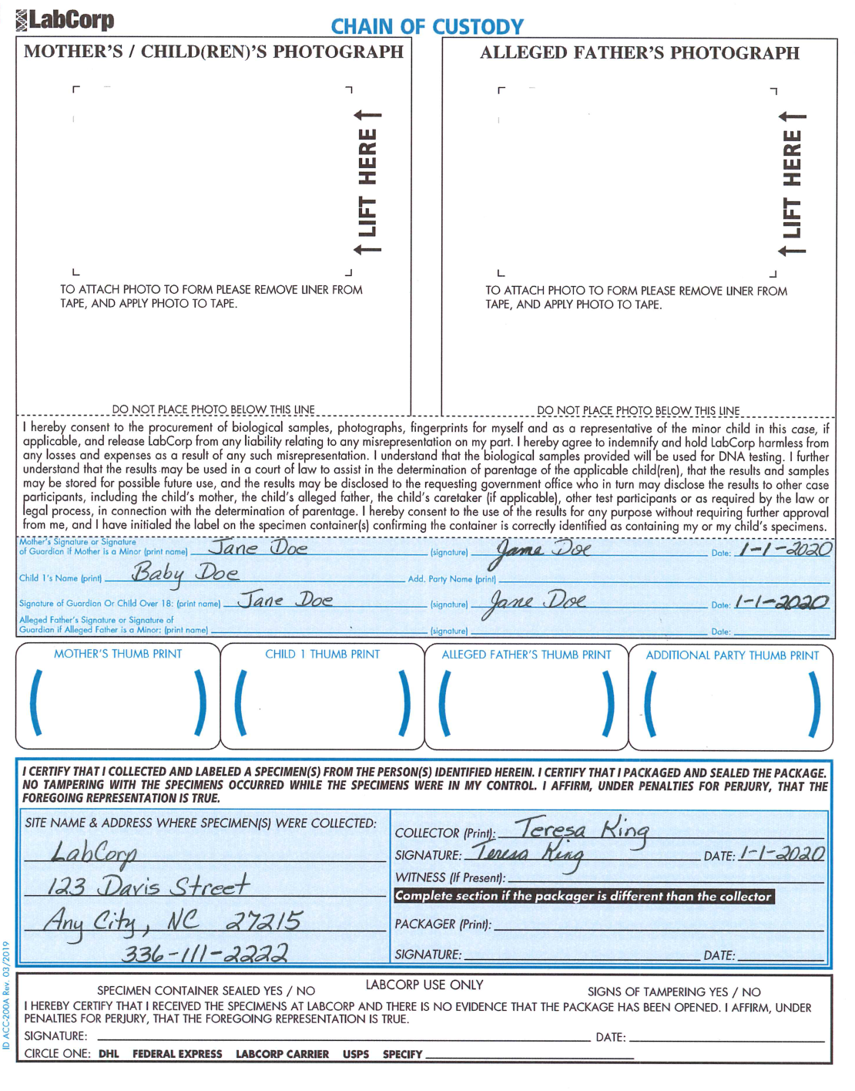
Take an instant photograph of the individual(s) collected and attach pictures here. If a camera is not available, photocopy their government ID and attach. If necessary tape, do not staple.
The adult individual photographed should print their name and date on the photo.
Jane Doe
Baby Doe 1/1/20
Have the adult individual(s) who were collected, print and sign their name, and date collected.
If required by the client, obtain thumb prints of all collected persons.
Provide the address where the specimens were collected.

Slide 7
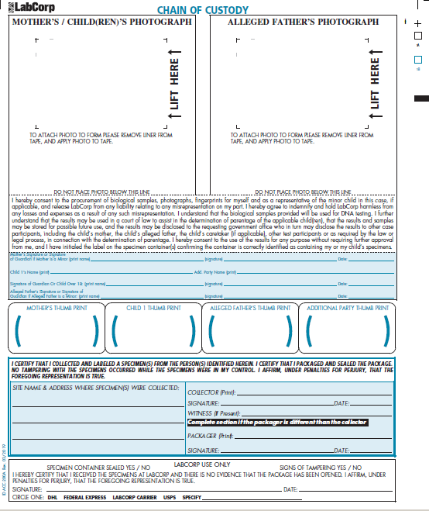
Witnessed Collection Signatures
Witnessed Collections require that the individual that performed the self-collection sign as the Collector and the individual that witnessed the collection procedure and completed the chain of custody documentation sign as Witness and Packager.
If the Mother and Alleged Father are present and self-collect their samples, they BOTH must print/sign as collectors.
If this section is incomplete a certificate/affidavit will be required in order to confirm the person that performed the collection.
Any State Child Support Office
Jane Doe / John Doe
04/04/20
Jane Doe / John Doe
123 Any Street
Staff Member or Regular Collector
Any Town, NC 11111
Staff Member or Regular Collector
111-222-3333
Staff Member or Regular Collector
04/04/20

Slide 8
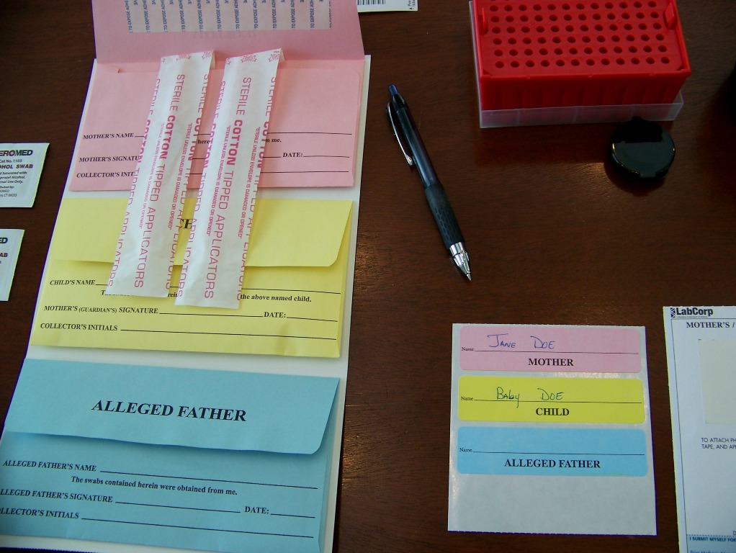
Now We Are Ready to Begin the Collection Process
Remove the swabs from the pink envelope. Notice that the swabs are color coded to match the envelopes and corresponding labels.

Slide 9
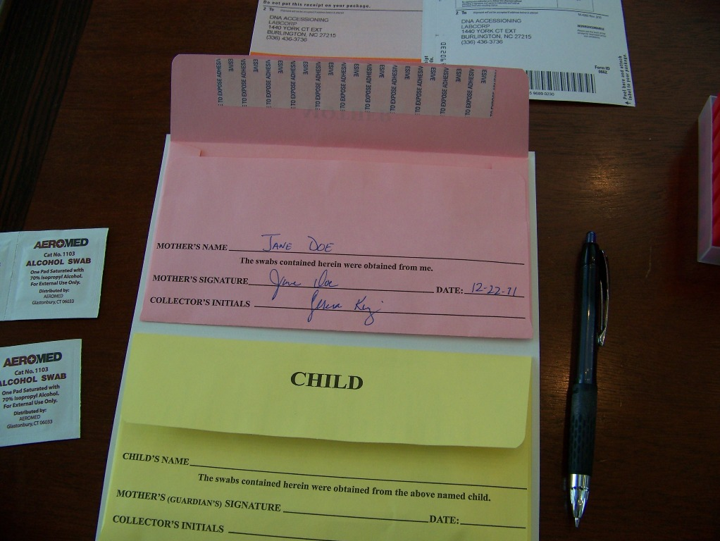
Instruct the party to print, date and sign their name on the appropriate color-coded envelope as indicated. Witnessed Collections require that the individual that has self-collected their DNA buccal swab sample must also sign as the Collector. The Witness must sign next to the Collector on this line and notate as “Witness” next to their signature.
A parent or guardian that has performed the buccal swab collection for a child must also sign as Collector on the child's envelope.

Slide 10
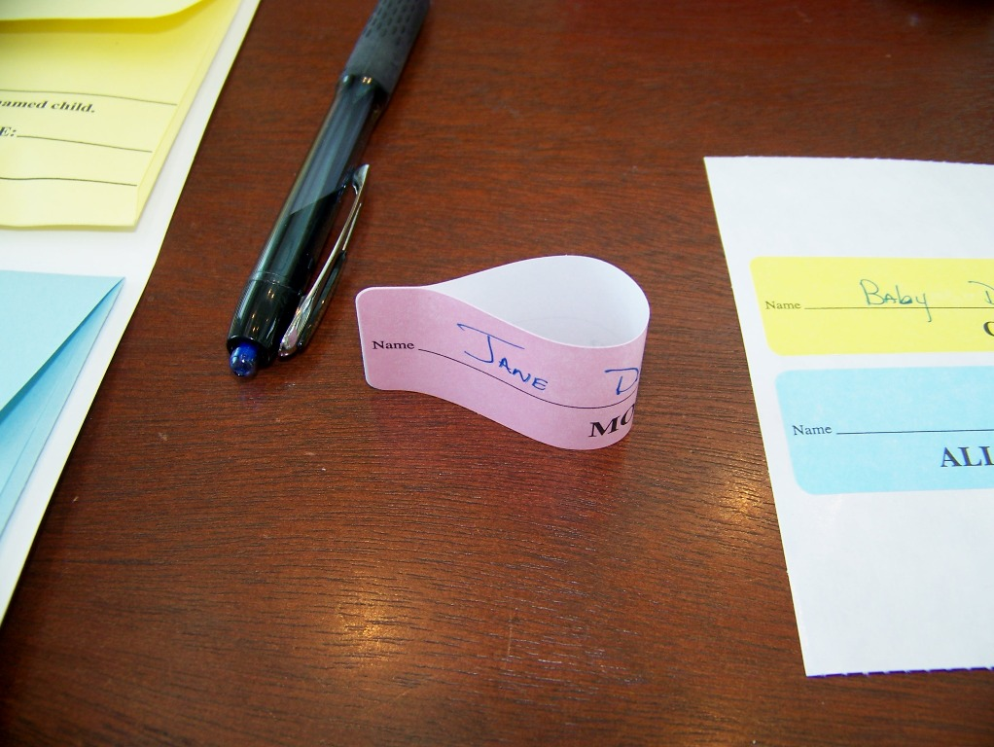
Complete the color-coded label and join the ends to make a loop.

Slide 11
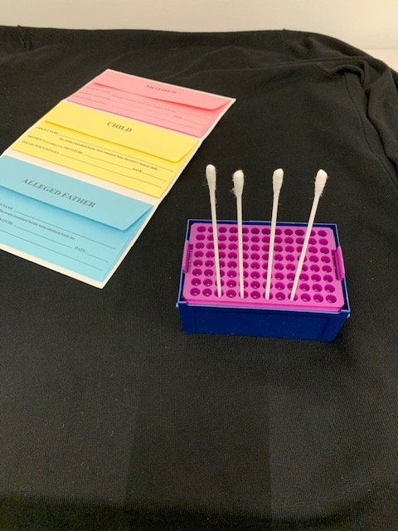
Witnessed Swab Collection Steps
The Witness must put on a clean pair of gloves.
Only one individual at a time should self-collect their samples so that the Witness may closely observe the collection process and maintain control of the collection supplies at all times.
Display the packaged sterile swabs, swab envelopes and drying rack in an area that is highly visible to the Witness and easily accessible to the individual that will be performing their self-collection.
Witness should remove the swabs from the color-coded envelope. Do not touch the sterile cotton tip of swabs or lay the swabs on any surface prior to or after collection.
Carefully place the swabs into the drying rack as shown in Exhibit A.
Pass the drying rack with the swabs to the individual for their self-collection.
Most importantly, the witness must maintain a line of sight with the person performing a self-collection.
Exhibit A

Slide 12
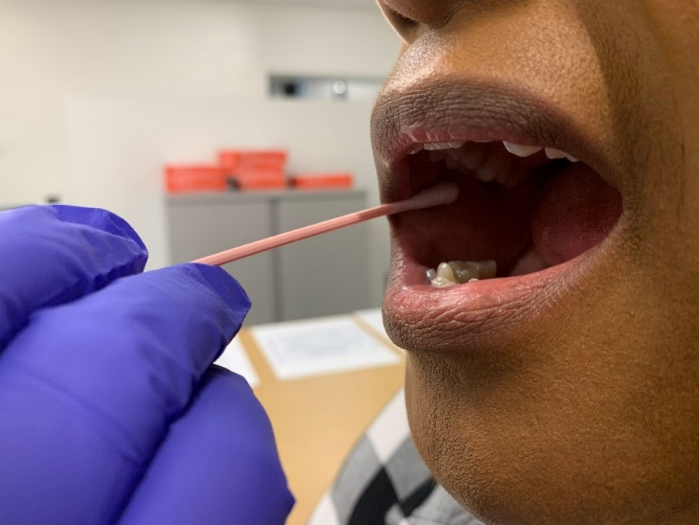
Request that the individual that is self-collecting swallow before swabbing.
Remind the individual of the importance to swab firmly against the inside of the cheek with enough pressure to allow the Witness to be able to see the movement of the cheek on the outside of the party’s mouth.
Ask the individual to insert a swab into quadrant #1 (Exhibit A) of their mouth. Instruct them to vigorously rub and roll the swab against the inside of the cheek for approximately ten (10) seconds.
The individual should insert the swab into the drying rack (Exhibit B) to prevent the tips from touching anything that might cause contamination. Allow swabs to air dry for a minimum of one minute.
Repeat this procedure with each of the three (3) remaining swabs in each of the remaining three (3) quadrants as shown.
Instruct the individual to place each swab back into the drying rack when they have completed the collection process.
Exhibit A
Exhibit B

Slide 13
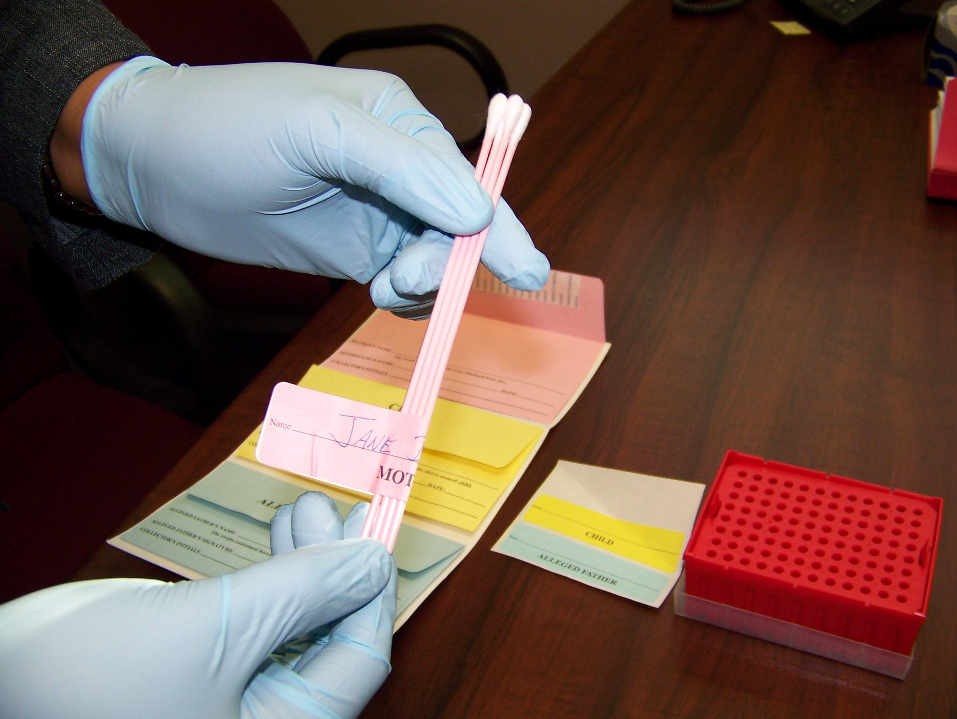
The Witness will remove the swabs from the drying rack and slide the color-coded swabs into the loop formed with the corresponding color-coded label and press together on the stick portion of the swab to secure. Ensure the names are visible and legible.
Do Not Wrap the label around the swabs

Slide 14
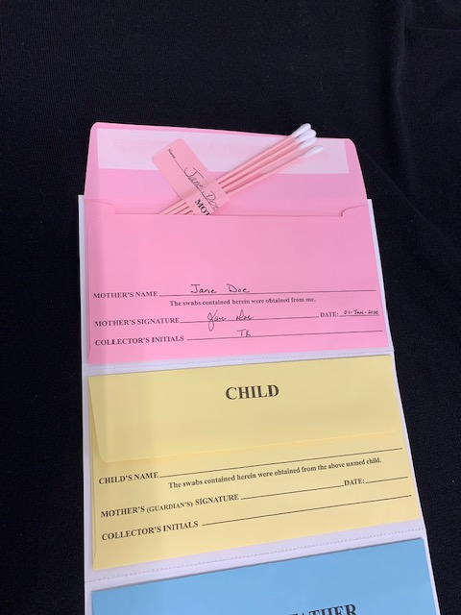
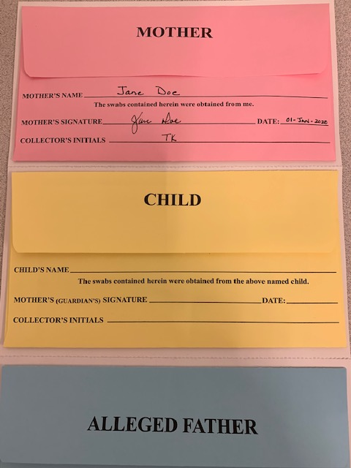
Verify that the color coded swabs match the color of the label.
Ensure that the name on the label matches the name on the envelope.
Insert the swabs into the corresponding color-coded envelope.
Remove the adhesive liner on the envelope and seal the envelope. Repeat these collection steps for all additional parties collected.

Slide 15
Chain of Custody Review
Please note this section. If this statement is present, the Witness must sign as Witness and Packager.
If the Specimen Collector and Person Packaging portion of the form is not completed correctly, it may delay the processing of the case. In addition, the collector will be sent a certificate/affidavit as appropriate, that will require completion. If an affidavit is required, it must be notarized prior to returning it to the laboratory. There are various versions of the chain of custody form, some of which require the signature of the packager and others requiring this signature only if the packager is not the individual that performed the collection.

Slide 16
Complete the Following Check List Before Packaging Samples for Transport
Item |  | Complete
#1 | Are reference numbers required/provided by this client?
#2 | Is the correct account number provided in the top left hand section on the front of Client Authorization form?
#3 | Are all parties names in the case provided in the "List All Parties" field? Mother not tested in this case? Write MNT in this field and in the Mother’s section of the Client Authorization form.
#4 | Have all of the shaded sections of the Client Authorization form been completed? If not, ensure completion before packaging the sample(s) and shipping to the laboratory. Request additional information as appropriate from the individual(s) that were collected and/or staff member that provided the Client Authorization form.
#5 | Are photos clear and each party identifiable? If unable to take a photograph at the time of collection, include explanation of why it was not obtained.
#6 | Is the consent section of the Client Authorization form complete? Ensure all information is provided, including the date of signature.
#7 | Is the collector information complete?
#8 | Is the collection site information complete?
#9 | Are the names and dates for each individual collected consistent on the corresponding color-coded label, envelope and chain of custody document?
Please check off each of these requirements prior to packaging the samples and before the individual(s) that were collected have left the collection area.
The Witness must print their name and collection date clearly at the top of the form and insert the form into the yellow tamper resistant bag along with the samples and Client Authorization form for each case.
The checklist is an additional training tool provided to collectors that is intended to identify areas where prompt feedback and/or additional instruction to the collector may be helpful.
Collector: (Print) _________________ Date: ________________

Slide 17
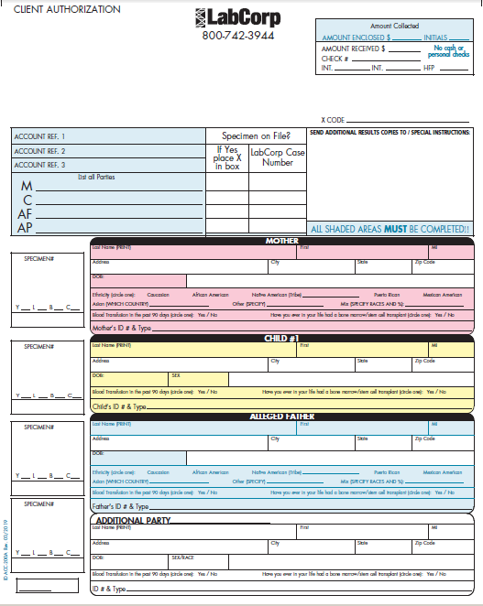
Client Authorization Checklist
ABC Paternity Testing
123 First Street
Anytown, NC 12345
Account #: 12345678
2. Labcorp Account # must be provided before sending to the laboratory.
1. If a reference number is required by the account, please request from the agency staff member that provided you with the chain of custody forms.
3. Must provide the names of all parties to be tested in the case in order for the laboratory to match them correctly.
*Exception: If the mother will not be tested for the case, do not include her name anywhere on the CA. Write MNT (Mother Not Tested) on the “M” line of the “List All Parties” section and also in the Name Field of the Mother’s section.
Please review this information for completeness prior to packaging the samples/chain of custody form for shipment to the Laboratory.
If any required information is incomplete, request assistance from the agency staff member that provided the chain of custody forms.
Familiarize yourself with the client’s additional requirements so that you recognize when necessary information is missing.
4. Must have all shaded areas completed.
*Race is a required section

Slide 18
5. Photos must be clear so that the individuals in the photos are easily identifiable. The quality of the photograph is very important to the proper identification of the collected persons and is essential to identifying imposters and prevention of potential fraud. Ensure that the individual's head and shoulders fill the viewing screen. Also inspect the photograph to ensure that it is not streaked, blurry, too dark, too light or otherwise distorted. If no photo is provided, provide an explanation of why it is absent.
6. Consent section must be completed in entirety.
7. Witnessed Collections require that the individual that performed the self-collection sign as the Collector and the individual that witnessed the collection procedure and completed the chain of custody documentation sign as Witness and Packager. If the Mother and Alleged Father are both present and self-collect their samples, they BOTH must print/sign as collectors. If this section is incomplete a certificate/affidavit will be required in order to confirm the person that performed the collection.
8. Collection site name and address must be completed. If incomplete a certificate/affidavit will be required in order to confirm where the samples were collected.

Slide 19
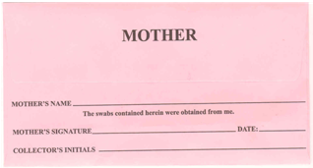
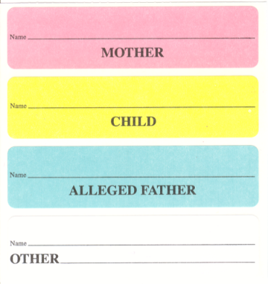
Collection Envelope Checklist
Complete all information on the sample envelopes and labels.
Ensure all names/dates are consistent for each individual collected on the corresponding color-coded label, envelope and on the chain of custody document.
Confirm that each individual that has been collected has signed their name exactly as they have signed on the front of the Client Authorization form.

Slide 20
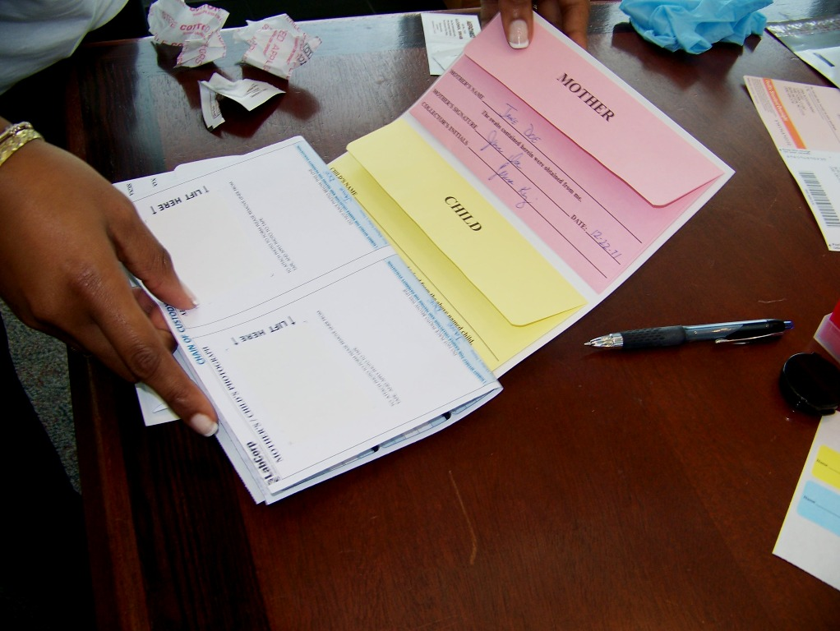
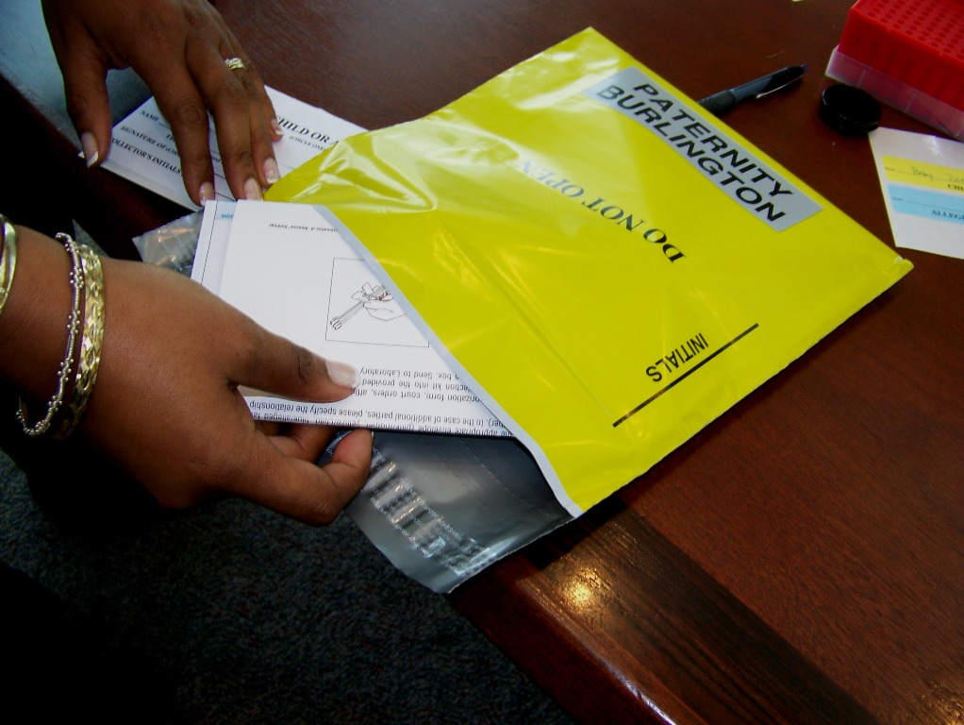
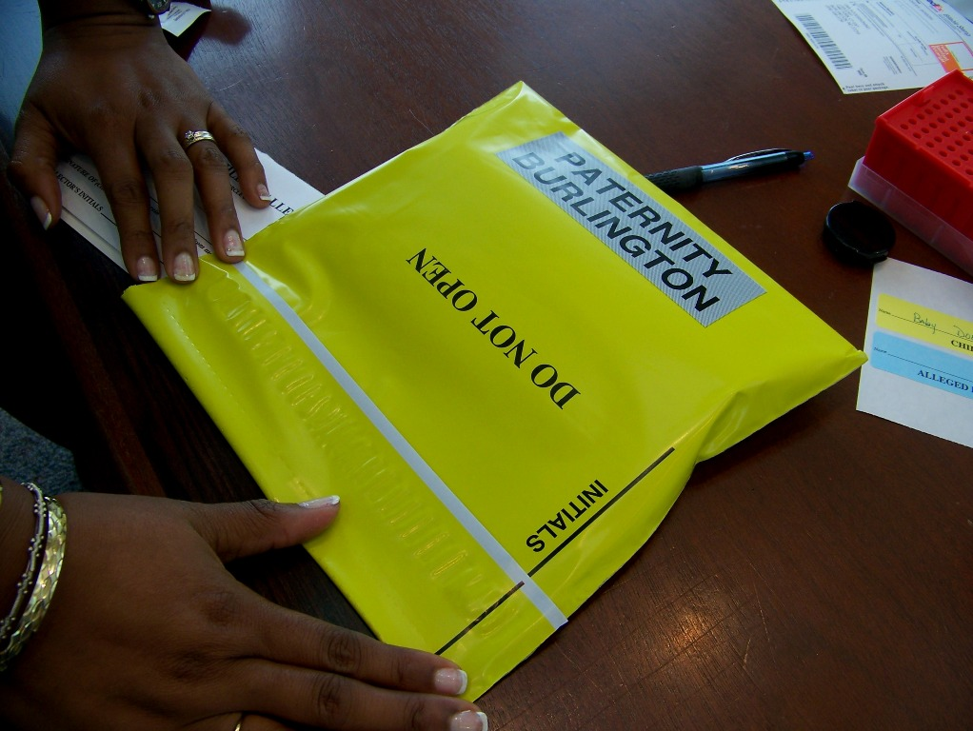
Exhibit A
Exhibit B
After collections for all individuals in the case have been completed, review the documentation for accuracy and completeness.
Fold together the chain of custody form and the collection kit. The collection kit should have the collection envelopes adhered and should contain the buccal swabs of all individuals that were collected as part of the case. (Exhibit A and B)
Place the kit and Client Authorization form into the tamper evident bag and seal. (Exhibit C and D)
Never leave a collection area until the kit is sealed and packaged for shipment.
Place the collection kits in a secure location should you need to leave a collection area.
Only one collection kit should be inserted into the yellow tamper evident bag.
Exhibit C
Exhibit D

Slide 21
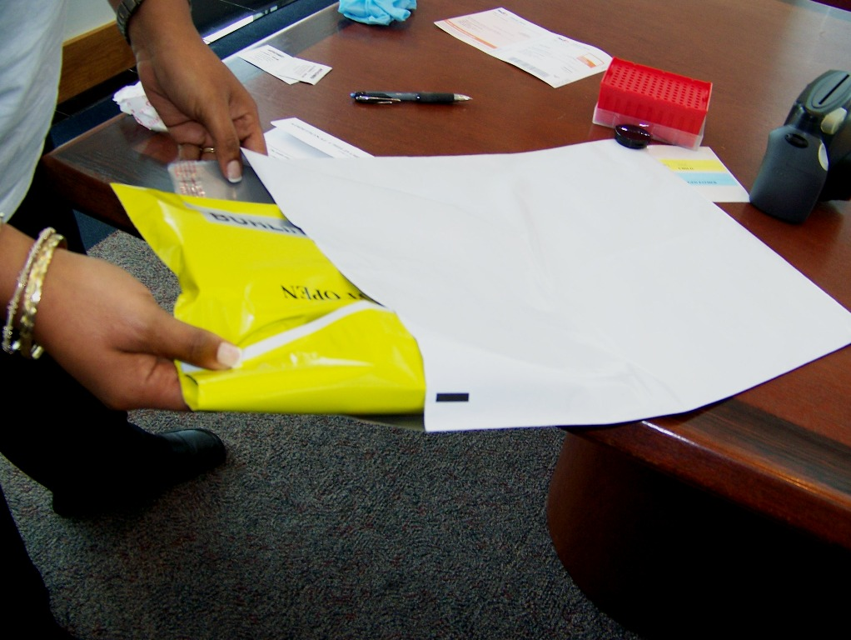
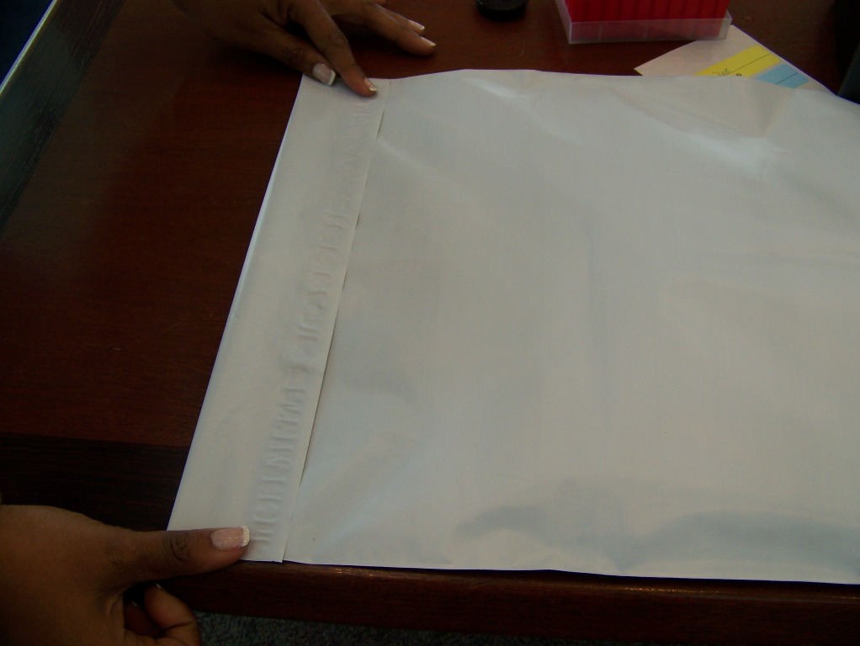
Initial the line as indicated on the yellow tamper resistant bag. Ensure your initials overlap the seal.
Insert the yellow bag into the FedEx shipping Pak.
Multiple tamper evident bags containing case samples may be inserted into a single FedEx shipping Pak. However, do not overfill to ensure that the shipping Pak can be completely sealed.
Use as many FedEx shipping Pak's as needed to properly package the yellow bags.
Seal the shipping Pak.
Ensure packages are placed in the area where the courier picks up. Do not leave packages unattended.

Slide 22
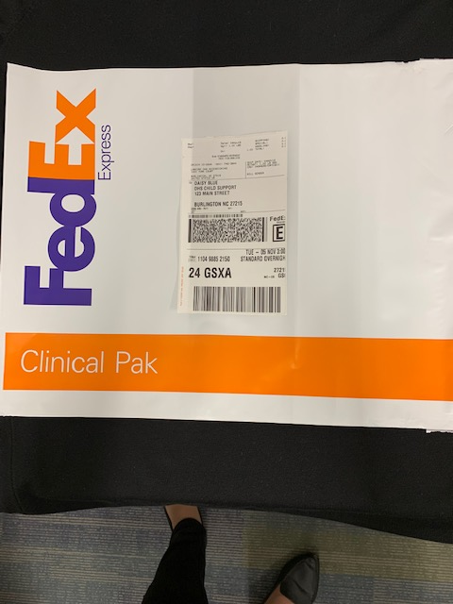
Attach the pre-printed mailing label to the shipping Pak. Keep the top portion of the label that contains the FedEx tracking number for your records. Do not roll or fold the shipping Pak.
If the courier or FedEx pickup has already taken place for the day and samples can not be shipped until the following day, store the package in a secure area.
Document the reason for delay of shipment as you may be required to provide explanation for delays in shipping.

Slide 23
New York Resident Considerations
Persons residing in New York cannot be involved in a paternity case without being ordered through Court Order, Physician’s Script, under a Child Support account or Court account, or Attorney’s Letter before results can be issued.
If a case arrives without proper documentation, we will send a request for the document to be provided and the case will be filed to await the order before the results can be sent.

Slide 24
Fuji Camera

Slide 25
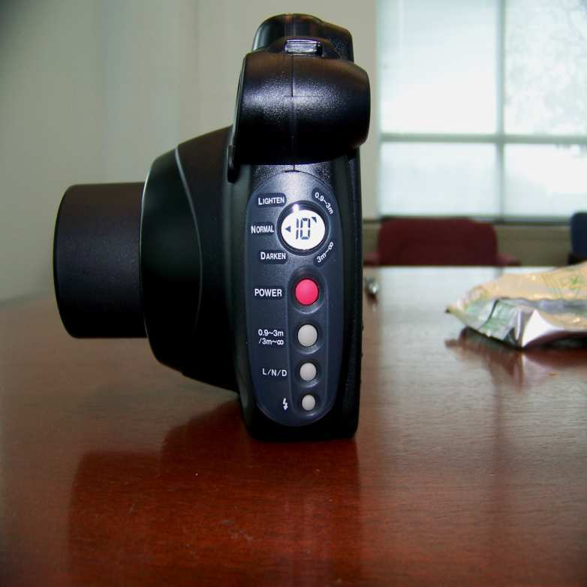
Please note the buttons on the side of the camera. This display notates how many pictures may be taken with the remaining film pack. Check this display often to mitigate running out of film.

Slide 26
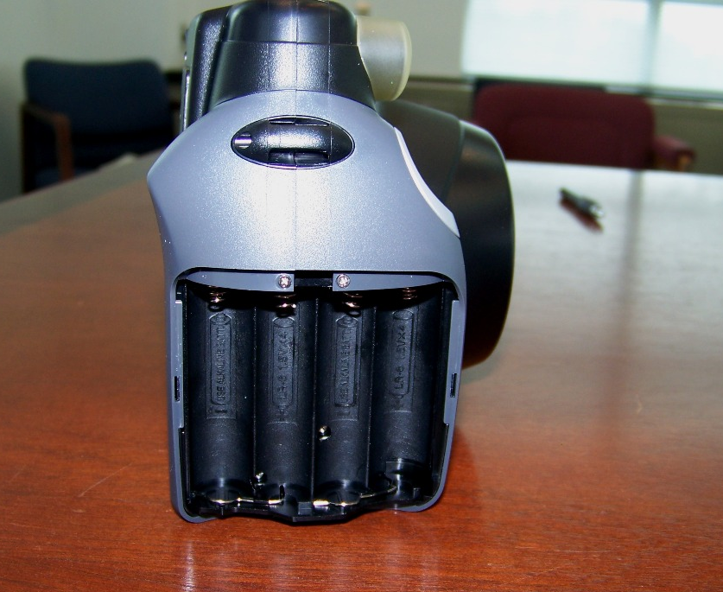
Remove battery cover and insert batteries.

Slide 27
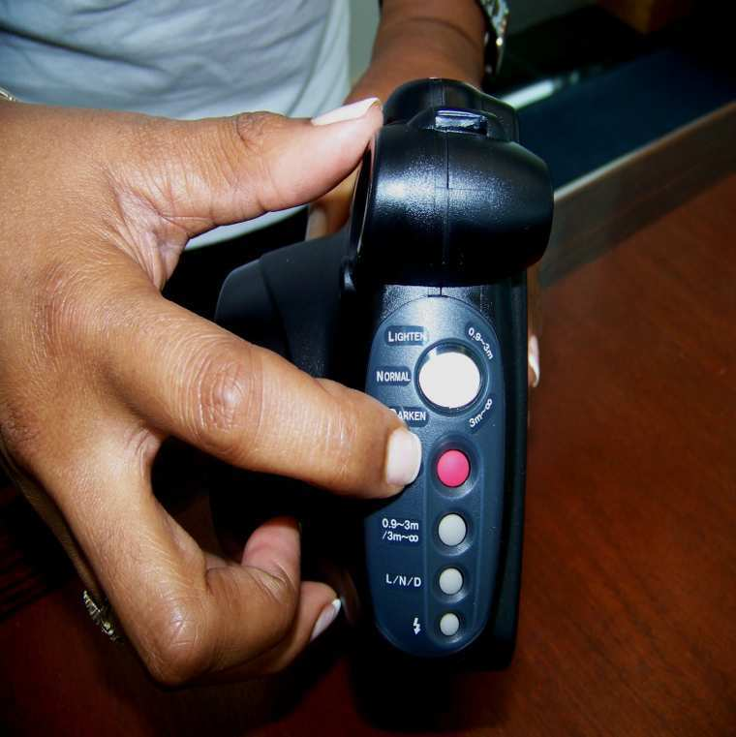
Press the power button to turn the camera on/off.

Slide 28
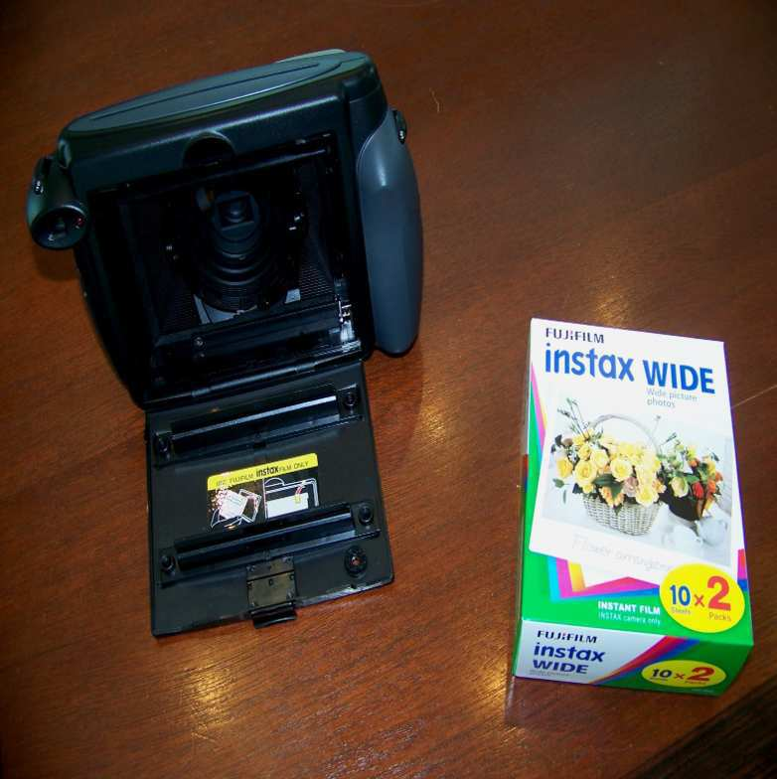
Open the back of the camera and open the box of film.

Slide 29
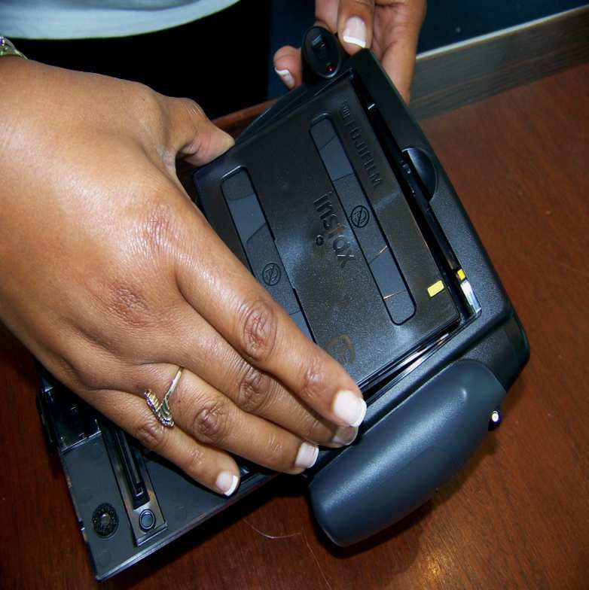
Insert film as shown.

Slide 30
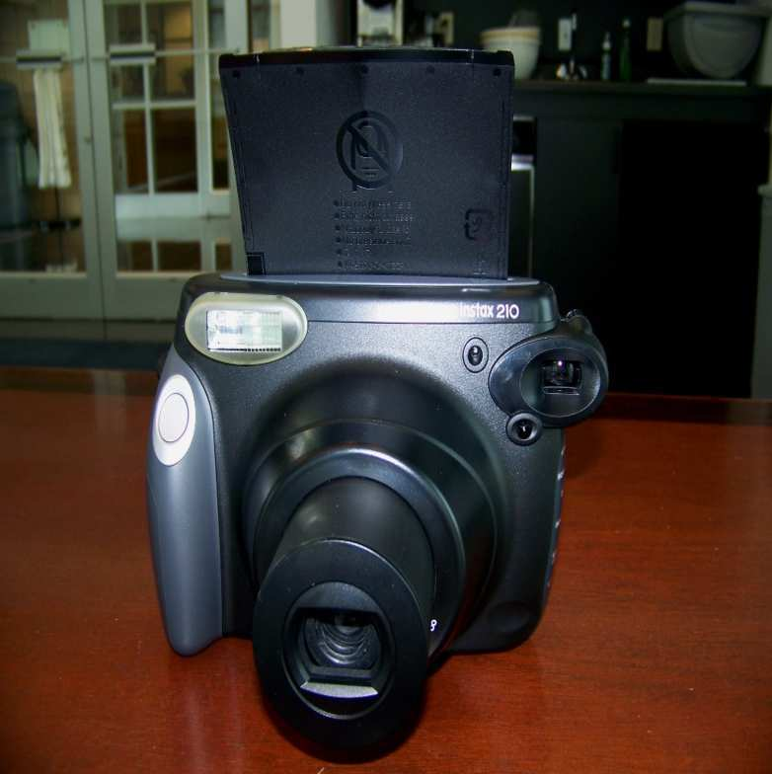
Press the button shown as if you are taking a picture to eject the cardboard from the film pack. Remove the cardboard and the camera
is ready to use.

Slide 31
Thank You
Please contact your Account Manager should you have additional questions or need further assistance.

